Slide 1
UIDAI Hackathon
Team Reference ID : 37nZpUOKci
Team Member Details
Sr. No. | Name | E Mail ID
1 | Aniket Kharpatil | aniketkharpatil@gmail.com
2 | Purvaja Kale | purvaja2507@gmail.com
3 | Harsh Kulkarni | harsh.kulkarni.42774@gmail.com
4 | Megh Kurlekar | megh.kurlekar@gmail.com

Slide 2
About the Problem Statement
Theme : Authentication Reimagined
Problem Statement: Usage of Aadhaar as an additional factor in a high value third party transaction: How can I try to connect. To edit offline, turn on offline sync. We use Aadhaar to improve the trust in a third party transaction. Can we get a “token” (digitally signed authentication response) from an Aadhaar authentication from online face authentication on the resident mobile and later use this token as an additional (second) factor of authentication in a third party application. As always, Aadhaar numbers should not be exposed to third party applications.

Slide 3
Approach
We are developing a Flutter based user application for providing 3rd party transaction using the client’s aadhar credentials with secure flow of user data.
Here we will be creating two apps using flutter:
Resident Application which will be on the user side and show their credentials mapped to their respective aadhar number.
Verifier Application (3rd party) which will be the database server storing all the tokens generated.
On the user side, we will use the uidai auth api and otp api for the registration of users into the app. For that the user will need to provide the registered mobile no. and an OTP will be sent to the user by uidai. Then we can generate a token by using the sha256 or md5 hash of aadhar credentials which the user has provided.User will be asked to create a unique userid. This userid and token will be stored in a 3rd party database and will be used for further verification and service-providing purposes.
Database: Firebase and firestore https://firebase.google.com/
Hashing algorithm dependency: https://pub.dev/packages/crypto

Slide 4
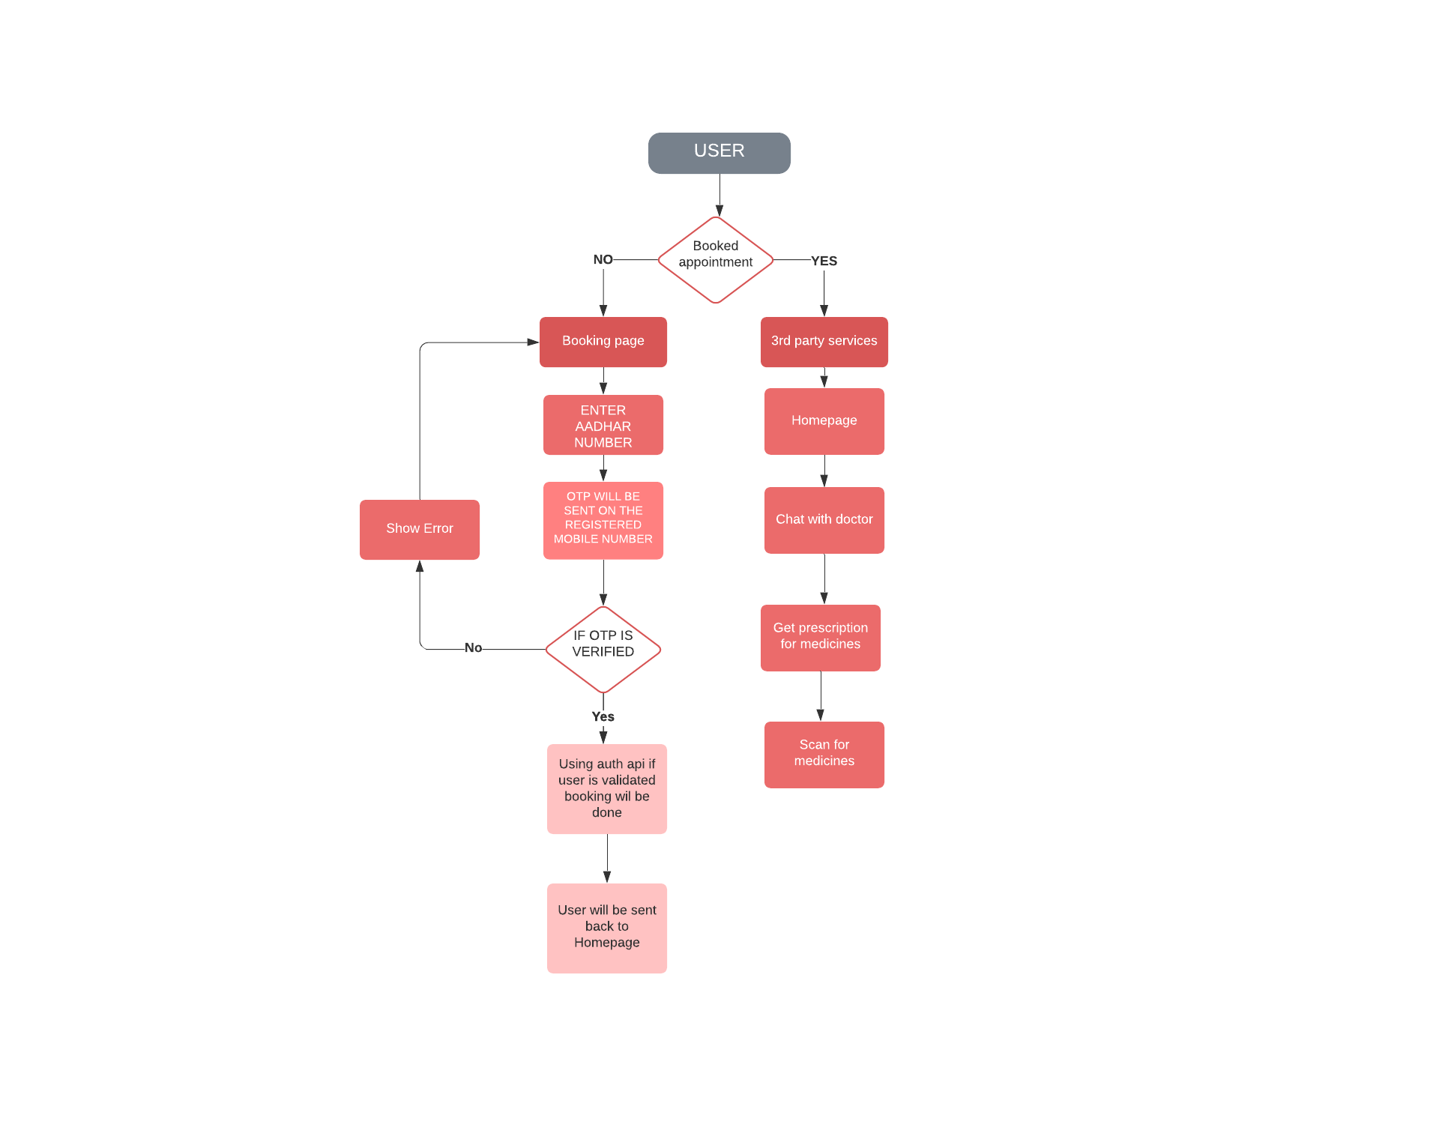
Architectural Diagram:

Slide 5
API Usage
OTP API: OTP Request API is used to generate OTP for resident whose mobile number is registered with his/her Aadhaar number. The generated OTP will be subsequently used for authentication.
AUTH API: Auth API is the single entry point for all modes of authentication in the UIDAI ecosystem. Auth API supports OTP, Face, Biometric,Demographic authentication. Any modality used by residents or organisations must call the Auth API to authenticate the resident.

Slide 6
Security Considerations
As we are going to hash the Aadhar credentials(eg. uid no of user) so the 3rd party server won’t be able to decode it or gain any credential access about users.
Also we are going to make use of already established Google’s Firebase Firestore which is highly secure and hence the 3rd party providers won’t be able to access or steal the users data.

Slide 7
Methodology:
EKYC API :
URL
https://stage1.uidai.gov.in/onlineekyc/getEkyc/
HTTP Method
POST
HTTP Request Headers
Content-Type: application/json
HTTP Request Body
{
"uid": "********7882",
"vid": "************9999",
"txnId": "0acbaa8b-b3ae-433d-a5d2-51250ea8e970", "otp": "122915"
}

Slide 8
Whenever a user tries to book an appointment with the doctor, the app will show a list of available doctors on the home page.
To book an appointment tap on "Book Now" button.
Then the user will be redirected to an aadhar uid page where he/she will be asked to enter the uid.
After that an OTP will get generated and messaged to the user's registered mobile number and user will be asked to enter the OTP.
After validation user will be shown the booking successful page.
User will be sent back to the Homepage.

Slide 9
App demo video link: https://vimeo.com/597918248
This is the old recording of our previous app in which are going to add aadhaar as a second factor authentication.
In our new app we have added the use of aadhar authentication for booking purpose.

Slide 10

Working app demo:

Slide 11
THANK YOU

